Slide 1
Battle of the Neighborhoods

Slide 2
Objective
The goal of this presentation is to locate the best area to open an Asian restaurant in the city of London.
we will approach this problem by applying machine learning techniques and data mining and analysis to model a proper solution to the problem.

Slide 3
Data
The data we will use as follows:
Foursquare Api
London City Hall website

Slide 4
Methodology
Our Methodology to approach this problem will be by understanding the social demography of the different neighborhoods and Boroughs to understand the ethnic distribution among the city and we will also the most popular venues in each area and try to get an understanding of the social taste for food and the statues of competing Asian restaurants. We will then apply k-means analysis to cluster the city and venues and reach conclusion on best cluster to open the business.
Our detailed approach will be by mining for data of the distribution of ethnic groups in London Boroughs and understand the demography of each borough and the ethnic concentration in each. We will then obtain the top venues in each borough using foursqaure API and will have a look at the top 10 venues in each borough. With these data we will apply k-means algorithm to cluster the boroughs and venues in clusters and analyze each to determine best cluster to achieve our objective.

Slide 5
Data Analysis
We obtained the and cleared the data from our sources and built a data frame of ethnic groups concentrations in London boroughs.

Slide 6
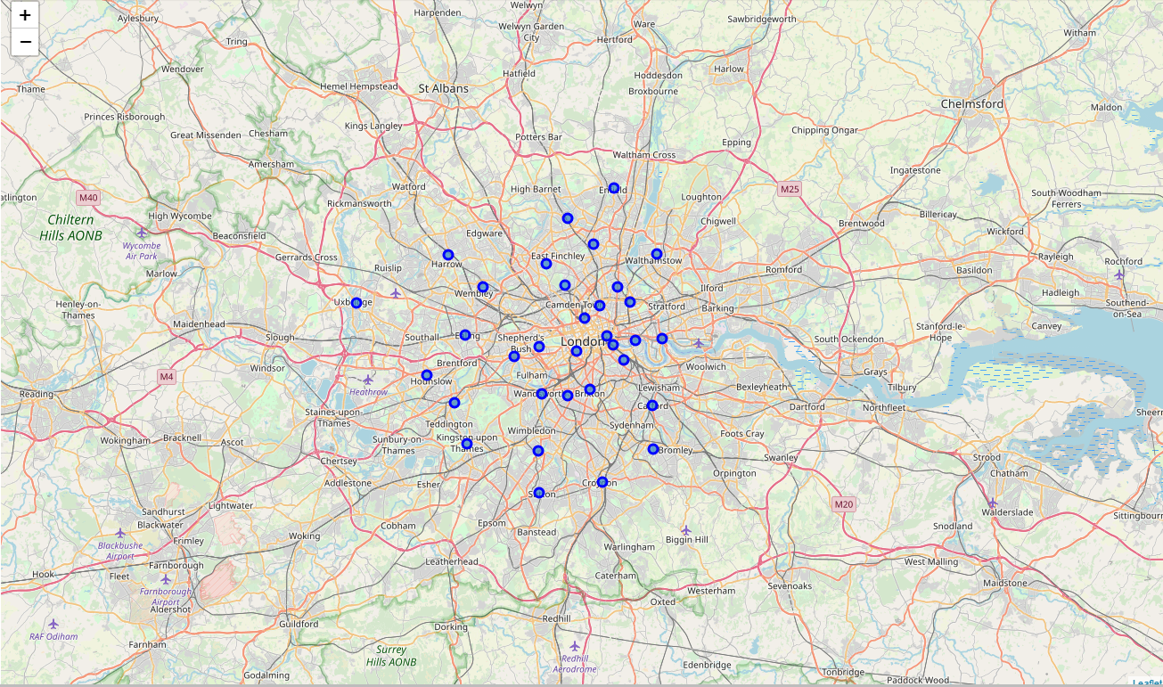
London Boroughs

Slide 7
Ethnic groups in London Boroughs
Borough | White British | White Irish | White Other | Mixed | Asian | Black | Other
Barking and Dagenham | 91,949 | 1,730 | 14,707 | 7,878 | 29,594 | 37,140 | 2,913
Barnet | 162,117 | 8,685 | 57,751 | 17,169 | 65,918 | 27,431 | 17,315
Bexley | 179,250 | 2,596 | 8,116 | 5,395 | 15,243 | 19,624 | 1,773
Brent | 55,887 | 12,320 | 44,673 | 15,775 | 105,986 | 58,632 | 17,942
Bromley | 239,478 | 4,463 | 16,929 | 10,897 | 16,067 | 18,686 | 2,872
Camden | 96,937 | 7,053 | 42,065 | 12,322 | 35,446 | 18,060 | 8,455
City of London | 4,243 | 180 | 1,376 | 289 | 940 | 193 | 154
Croydon | 171,740 | 5,369 | 23,086 | 23,895 | 59,627 | 73,256 | 6,405
Ealing | 103,035 | 10,428 | 52,355 | 15,066 | 100,439 | 36,860 | 20,266
Enfield | 126,450 | 6,899 | 57,291 | 17,183 | 34,893 | 53,687 | 16,063
Greenwich | 133,130 | 4,291 | 21,581 | 12,274 | 29,894 | 48,655 | 4,732
Hackney | 89,030 | 5,216 | 40,371 | 15,869 | 25,867 | 56,858 | 13,059
Hammersmith and Fulham | 81,989 | 6,321 | 35,912 | 10,044 | 16,635 | 21,505 | 10,087
Haringey | 88,424 | 6,997 | 58,922 | 16,548 | 24,150 | 47,830 | 12,055
Harrow | 73,826 | 7,336 | 19,829 | 9,499 | 101,808 | 19,708 | 7,050
Havering | 197,615 | 2,989 | 7,345 | 4,933 | 11,545 | 11,481 | 1,324
Hillingdon | 142,916 | 5,949 | 17,166 | 10,479 | 69,253 | 20,082 | 8,091
Hounslow | 96,264 | 4,775 | 29,466 | 10,349 | 87,257 | 16,813 | 9,033
Islington | 98,322 | 8,140 | 34,053 | 13,339 | 19,034 | 26,294 | 6,943
Kensington and Chelsea | 62,271 | 3,715 | 46,031 | 8,986 | 15,861 | 10,333 | 11,452
Kingston upon Thames | 101,015 | 2,718 | 15,486 | 6,269 | 26,152 | 4,021 | 4,399
Lambeth | 118,250 | 7,456 | 47,319 | 23,160 | 20,938 | 78,542 | 7,421
Lewisham | 114,446 | 5,206 | 28,034 | 20,472 | 25,534 | 74,942 | 7,251
Merton | 96,658 | 4,417 | 28,531 | 9,334 | 36,143 | 20,811 | 3,799
Newham | 51,516 | 2,172 | 35,528 | 13,945 | 133,895 | 60,256 | 10,672
Redbridge | 96,253 | 3,900 | 18,493 | 11,456 | 116,503 | 24,845 | 7,520
Richmond upon Thames | 133,582 | 4,766 | 22,377 | 6,780 | 13,607 | 2,816 | 3,062
Southwark | 114,534 | 6,222 | 35,593 | 17,778 | 27,192 | 77,511 | 9,453
Sutton | 134,854 | 3,219 | 11,376 | 7,134 | 22,035 | 9,120 | 2,408
Tower Hamlets | 79,231 | 3,863 | 31,725 | 10,360 | 104,501 | 18,629 | 5,787
Waltham Forest | 92,999 | 3,959 | 37,841 | 13,766 | 54,389 | 44,791 | 10,504
Wandsworth | 163,739 | 7,664 | 47,813 | 15,241 | 33,338 | 32,756 | 6,444
Westminster | 77,334 | 4,960 | 53,036 | 11,395 | 31,862 | 16,472 | 24,337

Slide 8
Venues
We extracted data from foursquare and has been able to reach the top 10 venues in each Borough

Slide 9
Venues
Borough | 1st Most Common Venue | 2nd Most Common Venue | 3rd Most Common Venue | 4th Most Common Venue | 5th Most Common Venue | 6th Most Common Venue | 7th Most Common Venue | 8th Most Common Venue | 9th Most Common Venue | 10th Most Common Venue
Barking and Dagenham | Mediterranean Restaurant | Café | Farmers Market | Food | Scenic Lookout | Grocery Store | Track Stadium | Trail | Bakery | Lake
Barnet | Café | Lawyer | Bus Stop | Yoga Studio | Fish & Chips Shop | Gaming Cafe | Furniture / Home Store | Fruit & Vegetable Store | Frozen Yogurt Shop | Fried Chicken Joint
Bexley | Grocery Store | Italian Restaurant | Fish & Chips Shop | Coffee Shop | Breakfast Spot | Supermarket | Fish Market | Bar | Historic Site | Caucasian Restaurant
Brent | Hotel | Clothing Store | Coffee Shop | Sporting Goods Shop | Bar | American Restaurant | Sandwich Place | Music Venue | Burger Joint | Grocery Store
Bromley | Café | Pub | Gastropub | Park | Gaming Cafe | Fruit & Vegetable Store | Frozen Yogurt Shop | Fried Chicken Joint | French Restaurant | Forest
Camden | Hotel | Coffee Shop | Pub | Café | Plaza | Italian Restaurant | Burger Joint | Garden | Bookstore | Deli / Bodega
City of London | Coffee Shop | Gym / Fitness Center | Seafood Restaurant | Italian Restaurant | Asian Restaurant | Pub | French Restaurant | Steakhouse | Restaurant | Hotel
Croydon | Coffee Shop | Pub | Gym / Fitness Center | Asian Restaurant | Portuguese Restaurant | Mediterranean Restaurant | Breakfast Spot | Brewery | Burger Joint | Burrito Place
Ealing | Coffee Shop | Clothing Store | Bakery | Bus Stop | Pub | Italian Restaurant | Park | Pizza Place | Hotel | Burger Joint
Enfield | Coffee Shop | Café | Clothing Store | Turkish Restaurant | Gift Shop | Bookstore | Supermarket | Department Store | Women's Store | Optical Shop
Greenwich | Brewery | Grocery Store | Recreation Center | Park | Café | Bar | Pharmacy | Italian Restaurant | Vietnamese Restaurant | Pub
Hackney | Pub | Coffee Shop | Café | Cocktail Bar | Grocery Store | Brewery | Bakery | Vietnamese Restaurant | Hotel | Clothing Store
Hammersmith and Fulham | Pub | Café | Hotel | Indian Restaurant | Italian Restaurant | Coffee Shop | Gastropub | Thai Restaurant | Bus Stop | Garden Center
Haringey | Fast Food Restaurant | Café | Indian Restaurant | Gym / Fitness Center | Portuguese Restaurant | Pub | Playground | Convenience Store | Park | Movie Theater
Harrow | Thai Restaurant | Indie Movie Theater | Indian Restaurant | Coffee Shop | Supermarket | Convenience Store | Yoga Studio | Food | Fish & Chips Shop | Fish Market
Havering | Park | Breakfast Spot | Forest | Yoga Studio | Garden Center | Gaming Cafe | Furniture / Home Store | Fruit & Vegetable Store | Frozen Yogurt Shop | Fried Chicken Joint
Hillingdon | Coffee Shop | Italian Restaurant | Clothing Store | Fast Food Restaurant | Dessert Shop | Toy / Game Store | Sandwich Place | Shopping Mall | Bookstore | Burger Joint
Hounslow | Bed & Breakfast | Café | Pizza Place | Park | Film Studio | Fruit & Vegetable Store | Frozen Yogurt Shop | Fried Chicken Joint | French Restaurant | Forest

Slide 10
Venues
Borough | 1st Most Common Venue | 2nd Most Common Venue | 3rd Most Common Venue | 4th Most Common Venue | 5th Most Common Venue | 6th Most Common Venue | 7th Most Common Venue | 8th Most Common Venue | 9th Most Common Venue | 10th Most Common Venue
Islington | Pub | Mediterranean Restaurant | Bakery | Middle Eastern Restaurant | French Restaurant | Cocktail Bar | Boutique | Park | Music Venue | Theater
Kensington and Chelsea | Clothing Store | Café | Hotel | French Restaurant | Restaurant | Bakery | Italian Restaurant | Garden | Burger Joint | Breakfast Spot
Kingston upon Thames | Coffee Shop | Café | Italian Restaurant | Clothing Store | Pub | Bookstore | Department Store | Burger Joint | Sushi Restaurant | Bakery
Lambeth | Caribbean Restaurant | Pub | Market | Pizza Place | Tapas Restaurant | Beer Bar | Mexican Restaurant | Coffee Shop | Gym / Fitness Center | Grocery Store
Lewisham | Supermarket | Grocery Store | Pub | Train Station | Coffee Shop | Platform | Italian Restaurant | Japanese Restaurant | Hardware Store | Shopping Mall
Merton | Park | Fast Food Restaurant | Supermarket | Café | Indian Restaurant | Bakery | Garden Center | Burger Joint | Grocery Store | Coffee Shop
Newham | Pub | Italian Restaurant | Hostel | Park | English Restaurant | Hotel | Indian Restaurant | Bus Stop | American Restaurant | Frozen Yogurt Shop
Redbridge | Pub | Café | Cocktail Bar | Turkish Restaurant | Pizza Place | Italian Restaurant | Spanish Restaurant | Burrito Place | Grocery Store | Nightclub
Richmond upon Thames | Coffee Shop | Pub | Italian Restaurant | Bus Stop | Indian Restaurant | Grocery Store | Sandwich Place | Pharmacy | Stationery Store | Café
Southwark | Coffee Shop | Pub | Restaurant | Bar | Scenic Lookout | English Restaurant | Café | Grocery Store | French Restaurant | Gym / Fitness Center
Sutton | Pub | Clothing Store | Coffee Shop | Bar | Sandwich Place | Café | Pizza Place | Italian Restaurant | Video Game Store | Bookstore
Tower Hamlets | Italian Restaurant | Coffee Shop | Hotel | Sandwich Place | Fried Chicken Joint | Outdoor Sculpture | Chinese Restaurant | Grocery Store | Gym / Fitness Center | Convenience Store
Waltham Forest | Pub | Gym | Coffee Shop | Tea Room | Gym / Fitness Center | Art Gallery | Beer Store | Pizza Place | Vegetarian / Vegan Restaurant | Pool
Wandsworth | Pub | Clothing Store | Coffee Shop | Asian Restaurant | Burger Joint | Breakfast Spot | Pizza Place | Supermarket | Gym / Fitness Center | Multiplex
Westminster | Sandwich Place | Hotel | Coffee Shop | Theater | Italian Restaurant | Gym / Fitness Center | Pub | Café | Hotel Bar | Sushi Restaurant

Slide 11
K Mean Analysis
We Applied K- means analysis to cluster our data.
Optimum K = 5 clusters

Slide 12
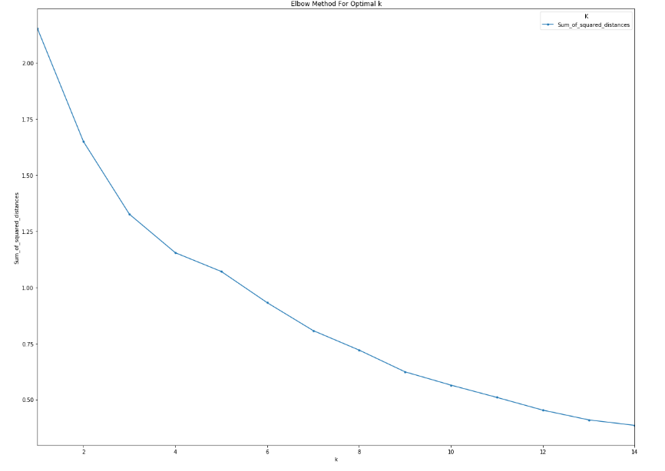
K Mean Analysis

Slide 13
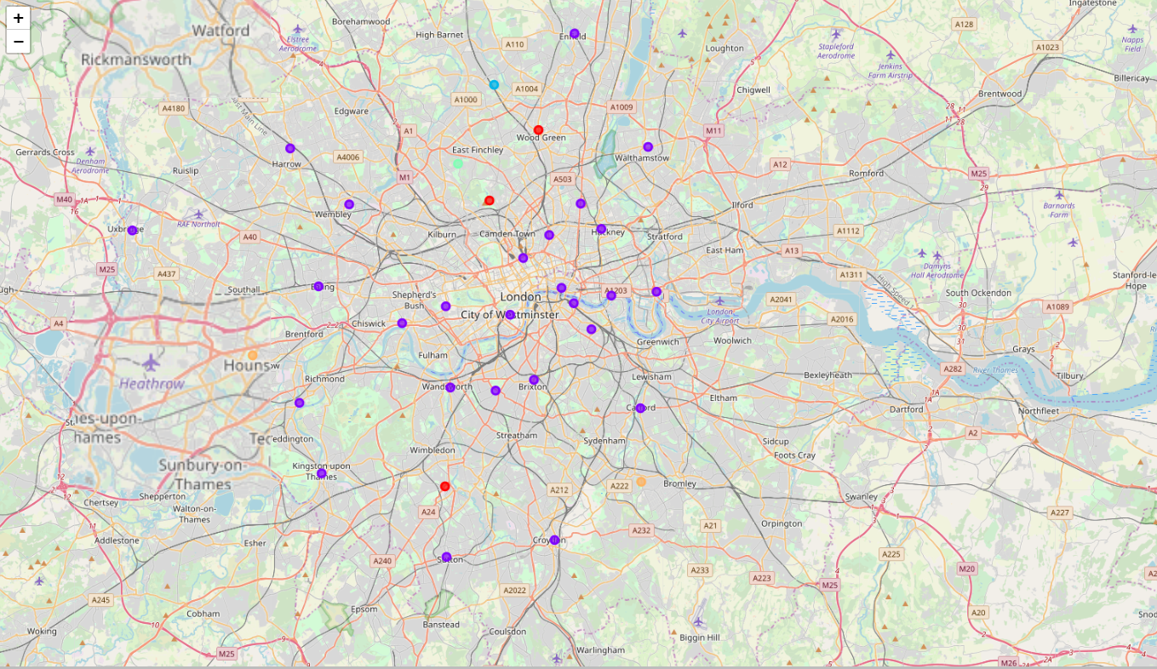
London map by clusters

Slide 14
Results
Cluster 1
Borough | White British | White Irish | White Other | Mixed | Asian | Black | Other | Cluster Labels | 1st Most Common Venue | 2nd Most Common Venue | 3rd Most Common Venue | 4th Most Common Venue | 5th Most Common Venue | 6th Most Common Venue | 7th Most Common Venue | 8th Most Common Venue | 9th Most Common Venue | 10th Most Common Venue
Merton | 96658 | 4417 | 28531 | 9334 | 36143 | 20811 | 3799 | 0 | Park | Fast Food Restaurant | Supermarket | Café | Indian Restaurant | Bakery | Garden Center | Burger Joint | Grocery Store | Coffee Shop
Haringey | 88424 | 6997 | 58922 | 16548 | 24150 | 47830 | 12055 | 0 | Fast Food Restaurant | Café | Indian Restaurant | Gym / Fitness Center | Portuguese Restaurant | Pub | Playground | Convenience Store | Park | Movie Theater
Barking and Dagenham | 91949 | 1730 | 14707 | 7878 | 29594 | 37140 | 2913 | 0 | Mediterranean Restaurant | Café | Farmers Market | Food | Scenic Lookout | Grocery Store | Track Stadium | Trail | Bakery | Lake

Slide 15
Cluster 2
Borough | White British | White Irish | White Other | Mixed | Asian | Black | Other | 1st Most Common Venue | 2nd Most Common Venue | 3rd Most Common Venue | 4th Most Common Venue | 5th Most Common Venue | 6th Most Common Venue | 7th Most Common Venue | 8th Most Common Venue | 9th Most Common Venue | 10th Most Common Venue
Westminster | 77334 | 4960 | 53036 | 11395 | 31862 | 16472 | 24337 | Sandwich Place | Hotel | Coffee Shop | Theater | Italian Restaurant | Gym / Fitness Center | Pub | Café | Hotel Bar | Sushi Restaurant
Wandsworth | 163739 | 7664 | 47813 | 15241 | 33338 | 32756 | 6444 | Pub | Clothing Store | Coffee Shop | Asian Restaurant | Burger Joint | Breakfast Spot | Pizza Place | Supermarket | Gym / Fitness Center | Multiplex
Waltham Forest | 92999 | 3959 | 37841 | 13766 | 54389 | 44791 | 10504 | Pub | Gym | Coffee Shop | Tea Room | Gym / Fitness Center | Art Gallery | Beer Store | Pizza Place | Vegetarian / Vegan Restaurant | Pool
Tower Hamlets | 79231 | 3863 | 31725 | 10360 | 104501 | 18629 | 5787 | Italian Restaurant | Coffee Shop | Hotel | Sandwich Place | Fried Chicken Joint | Outdoor Sculpture | Chinese Restaurant | Grocery Store | Gym / Fitness Center | Convenience Store
Sutton | 134854 | 3219 | 11376 | 7134 | 22035 | 9120 | 2408 | Pub | Clothing Store | Coffee Shop | Bar | Sandwich Place | Café | Pizza Place | Italian Restaurant | Video Game Store | Bookstore
Southwark | 114534 | 6222 | 35593 | 17778 | 27192 | 77511 | 9453 | Coffee Shop | Pub | Restaurant | Bar | Scenic Lookout | English Restaurant | Café | Grocery Store | French Restaurant | Gym / Fitness Center
Richmond upon Thames | 133582 | 4766 | 22377 | 6780 | 13607 | 2816 | 3062 | Coffee Shop | Pub | Italian Restaurant | Bus Stop | Indian Restaurant | Grocery Store | Sandwich Place | Pharmacy | Stationery Store | Café
Redbridge | 96253 | 3900 | 18493 | 11456 | 116503 | 24845 | 7520 | Pub | Café | Cocktail Bar | Turkish Restaurant | Pizza Place | Italian Restaurant | Spanish Restaurant | Burrito Place | Grocery Store | Nightclub
Newham | 51516 | 2172 | 35528 | 13945 | 133895 | 60256 | 10672 | Pub | Italian Restaurant | Hostel | Park | English Restaurant | Hotel | Indian Restaurant | Bus Stop | American Restaurant | Frozen Yogurt Shop
Lewisham | 114446 | 5206 | 28034 | 20472 | 25534 | 74942 | 7251 | Supermarket | Grocery Store | Pub | Train Station | Coffee Shop | Platform | Italian Restaurant | Japanese Restaurant | Hardware Store | Shopping Mall
Lambeth | 118250 | 7456 | 47319 | 23160 | 20938 | 78542 | 7421 | Caribbean Restaurant | Pub | Market | Pizza Place | Tapas Restaurant | Beer Bar | Mexican Restaurant | Coffee Shop | Gym / Fitness Center | Grocery Store
Kingston upon Thames | 101015 | 2718 | 15486 | 6269 | 26152 | 4021 | 4399 | Coffee Shop | Café | Italian Restaurant | Clothing Store | Pub | Bookstore | Department Store | Burger Joint | Sushi Restaurant | Bakery
Kensington and Chelsea | 62271 | 3715 | 46031 | 8986 | 15861 | 10333 | 11452 | Clothing Store | Café | Hotel | French Restaurant | Restaurant | Bakery | Italian Restaurant | Garden | Burger Joint | Breakfast Spot
Islington | 98322 | 8140 | 34053 | 13339 | 19034 | 26294 | 6943 | Pub | Mediterranean Restaurant | Bakery | Middle Eastern Restaurant | French Restaurant | Cocktail Bar | Boutique | Park | Music Venue | Theater
Hillingdon | 142916 | 5949 | 17166 | 10479 | 69253 | 20082 | 8091 | Coffee Shop | Italian Restaurant | Clothing Store | Fast Food Restaurant | Dessert Shop | Toy / Game Store | Sandwich Place | Shopping Mall | Bookstore | Burger Joint
Harrow | 73826 | 7336 | 19829 | 9499 | 101808 | 19708 | 7050 | Thai Restaurant | Indie Movie Theater | Indian Restaurant | Coffee Shop | Supermarket | Convenience Store | Yoga Studio | Food | Fish & Chips Shop | Fish Market
Hammersmith and Fulham | 81989 | 6321 | 35912 | 10044 | 16635 | 21505 | 10087 | Pub | Café | Hotel | Indian Restaurant | Italian Restaurant | Coffee Shop | Gastropub | Thai Restaurant | Bus Stop | Garden Center
Hackney | 89030 | 5216 | 40371 | 15869 | 25867 | 56858 | 13059 | Pub | Coffee Shop | Café | Cocktail Bar | Grocery Store | Brewery | Bakery | Vietnamese Restaurant | Hotel | Clothing Store
Greenwich | 133130 | 4291 | 21581 | 12274 | 29894 | 48655 | 4732 | Brewery | Grocery Store | Recreation Center | Park | Café | Bar | Pharmacy | Italian Restaurant | Vietnamese Restaurant | Pub
Enfield | 126450 | 6899 | 57291 | 17183 | 34893 | 53687 | 16063 | Coffee Shop | Café | Clothing Store | Turkish Restaurant | Gift Shop | Bookstore | Supermarket | Department Store | Women's Store | Optical Shop
Ealing | 103035 | 10428 | 52355 | 15066 | 100439 | 36860 | 20266 | Coffee Shop | Clothing Store | Bakery | Bus Stop | Pub | Italian Restaurant | Park | Pizza Place | Hotel | Burger Joint
Croydon | 171740 | 5369 | 23086 | 23895 | 59627 | 73256 | 6405 | Coffee Shop | Pub | Gym / Fitness Center | Asian Restaurant | Portuguese Restaurant | Mediterranean Restaurant | Breakfast Spot | Brewery | Burger Joint | Burrito Place
City of London | 4243 | 180 | 1376 | 289 | 940 | 193 | 154 | Coffee Shop | Gym / Fitness Center | Seafood Restaurant | Italian Restaurant | Asian Restaurant | Pub | French Restaurant | Steakhouse | Restaurant | Hotel
Camden | 96937 | 7053 | 42065 | 12322 | 35446 | 18060 | 8455 | Hotel | Coffee Shop | Pub | Café | Plaza | Italian Restaurant | Burger Joint | Garden | Bookstore | Deli / Bodega
Brent | 55887 | 12320 | 44673 | 15775 | 105986 | 58632 | 17942 | Hotel | Clothing Store | Coffee Shop | Sporting Goods Shop | Bar | American Restaurant | Sandwich Place | Music Venue | Burger Joint | Grocery Store
Bexley | 179250 | 2596 | 8116 | 5395 | 15243 | 19624 | 1773 | Grocery Store | Italian Restaurant | Fish & Chips Shop | Coffee Shop | Breakfast Spot | Supermarket | Fish Market | Bar | Historic Site | Caucasian Restaurant

Slide 16
Results
Cluster 3
Borough | White British | White Irish | White Other | Mixed | Asian | Black | Other | Cluster Labels | 1st Most Common Venue | 2nd Most Common Venue | 3rd Most Common Venue | 4th Most Common Venue | 5th Most Common Venue | 6th Most Common Venue | 7th Most Common Venue | 8th Most Common Venue | 9th Most Common Venue | 10th Most Common Venue
Barnet | 162117 | 8685 | 57751 | 17169 | 65918 | 27431 | 17315 | 2 | Café | Lawyer | Bus Stop | Yoga Studio | Fish & Chips Shop | Gaming Cafe | Furniture / Home Store | Fruit & Vegetable Store | Frozen Yogurt Shop | Fried Chicken Joint

Slide 17
Results
Cluster 4
Borough | White British | White Irish | White Other | Mixed | Asian | Black | Other | Cluster Labels | 1st Most Common Venue | 2nd Most Common Venue | 3rd Most Common Venue | 4th Most Common Venue | 5th Most Common Venue | 6th Most Common Venue | 7th Most Common Venue | 8th Most Common Venue | 9th Most Common Venue | 10th Most Common Venue
Havering | 197615 | 2989 | 7345 | 4933 | 11545 | 11481 | 1324 | 3 | Park | Breakfast Spot | Forest | Yoga Studio | Garden Center | Gaming Cafe | Furniture / Home Store | Fruit & Vegetable Store | Frozen Yogurt Shop | Fried Chicken Joint

Slide 18
Results
Cluster 5
Borough | White British | White Irish | White Other | Mixed | Asian | Black | Other | Cluster Labels | 1st Most Common Venue | 2nd Most Common Venue | 3rd Most Common Venue | 4th Most Common Venue | 5th Most Common Venue | 6th Most Common Venue | 7th Most Common Venue | 8th Most Common Venue | 9th Most Common Venue | 10th Most Common Venue
Hounslow | 96264 | 4775 | 29466 | 10349 | 87257 | 16813 | 9033 | 4 | Bed & Breakfast | Café | Pizza Place | Park | Film Studio | Fruit & Vegetable Store | Frozen Yogurt Shop | Fried Chicken Joint | French Restaurant | Forest
Bromley | 239478 | 4463 | 16929 | 10897 | 16067 | 18686 | 2872 | 4 | Café | Pub | Gastropub | Park | Gaming Cafe | Fruit & Vegetable Store | Frozen Yogurt Shop | Fried Chicken Joint | French Restaurant | Forest

Slide 19
Discussion
By checking and analyzing the results of our model we can find many interesting output that can guide us to our final conclusion.
In cluster one we notice that the Asian population compared to other ethnicities is relatively low, also it shows an Indian restaurant that is popular.
Cluster two Asian population compared to other ethnicities is relatively low, also it shows there is a Chinese, Japanese and an Indian restaurant that are popular which indicates that this cluster is not the best for business.
Cluster three we see that the Asian population is high compared to other ethnicities and no Asian restaurants as competition which might indicate the existence of business opportunity.
In cluster four the Asian population is very low compared to other ethnicities however the population density is high and no Asian restaurants.
Cluster five, Here the Asian population is very high compared to other ethnicities and no Asian restaurants in the popular venues which indicates an opportunity to enter an established market with limited competition.

Slide 20
Conclusion
By looking at the results we find that Cluster 5 is the best option for us as the Asian population density is considered high and no popular Asian venues in the market which will limit the competition when penetration the market.

